Slide 1


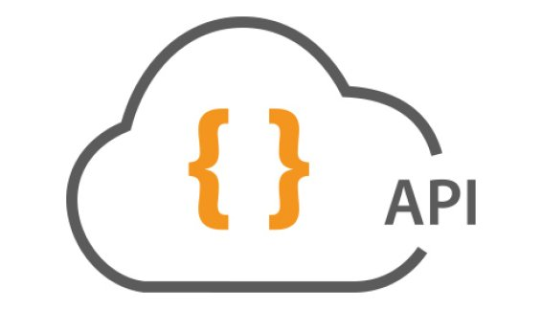

ASP.NET Core Web API
REST Standard, Consuming Services, Content Negotiation
C# MVC Frameworks
SoftUni Team
Technical Trainers
Software University
http://softuni.bg

Slide 2



Table of Contents

Slide 3
Questions
sli.do #csharp-web

Slide 4


What is ASP.NET Core Web API?
Web API

Slide 5



ASP.NET Core Web API
ASP.NET Core Web API
No longer a separated Framework (unlike ASP.NET MVC)
Has many things in common with MVC type applications

Slide 6



ASP.NET Core Web API
HTTP GET
Data storage
XML
JSON
Data Layer (EF)
Web API
Models
XML
JSON
HTTP PUT, POST, DELETE

Slide 7
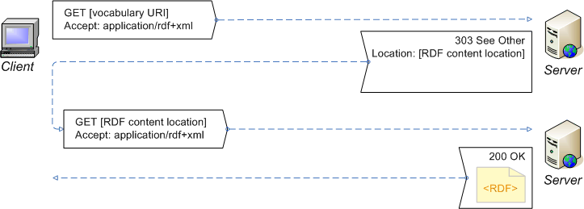
ASP.NET Core Web API Features
Easy to develop and consume
Modern HTTP programming model
Access to strongly typed HTTP object model
Content negotiation
Client and server negotiate about the right data format
Default format is JSON

Slide 8
ASP.NET Core Web API Features
Model binding and validation
Combine HTTP data in POCO models
Data validation via attributes
Supports the same model binding and validation infrastructure as ASP.NET Core MVC
Routes (mapping between URIs and code)
Full set of routing capabilities supported within ASP.NET Core

Slide 9
Web API Features (3)
Filters
Easily decorates Web API with additional validation
Authorization, CORS, etc.
Testability
IoC & Dependency injection support
Flexible hosting (IIS, Azure, self-hosting (Kestrel))

Slide 10


Web API Controllers

Slide 11
ASP.NET Core Web API Controllers
A controller class handles HTTP requests
Web API controllers derive from Controller
ASP.NET Core Web API by default maps HTTP requests to specific methods called "actions"
Action | HTTP method | Relative URI | Method
Get a list of all posts | GET | /api/posts | Get()
Get a post by ID | GET | /api/posts/id | Get(int id)
Create a new post | POST | /api/posts | Post(PostModel value)
Update a post | PUT | /api/posts/id | Put(int id, PostModel value)
Delete a post | DELETE | /api/posts/id | Delete(int id)
Get a post by category | GET | /api/posts?category=news | Get(string category)

Slide 12
ASP.NET Core Web API Request Processing
Web request is sent
Match controller from route
Controller Responds
public class PostsController : Controller
{
public string Get()
{
return "Some data"; }
public string Edit(Post post)
{
...
}
}
public class UsersController : Controller
{
...
}
http://localhost:1337/api/posts
GET /api/posts HTTP/1.1
Host: localhost:1337
Cache-Control: no-cache
HTTP/1.1 200 OK
Content-Length: 11
"some data"

Slide 13
Default Route
ASP.NET Core Web API maps default routes almost the same way as ASP.NET Core MVC Applications.
app.UseMvc(routes =>
{
routes.MapWebApiRoute("DefaultApi", "api/{controller}/{id?}");
});

Slide 14

Return Types
IHttpActionResult
T, IEnumerable<T>, IActionResult

Slide 15
Return Types
Actions can return several types.
Returned data automatically serialized to JSON or XML
T – generic type (can be anything)
IEnumerable<T> - foreach-able collection of generic type T
public Comment GetCommentById(int id) { ... }
public IEnumerable<Comment> GetPostComments(int id) { ... }

Slide 16
Return Types (2)
void – returns empty HTTP response 204 (No Content)
IActionResult – returns an abstract HTTP response with status code + data
public IActionResult GetPostComments(int id)
{
var context = new ForumContext();
var post = context.Posts.FirstOrDefault(p => p.Id == id);
if (post == null)
return this.BadRequest("Invalid post id");
return this.Ok(post);
}
200 OK + serialized data

Slide 17
HTTP Status Codes
It's a good practice always to return a status code
Return data with concrete status code method (e.g. Ok(), BadRequest(), NotFound(), Unauthorized(), etc.)
Return only status code
var top10Users = context.Users.All()
.Take(10)
.Select(u => u.Username);
return this.Ok(top10Users);
return this.StatusCode(HttpStatusCode.Forbidden);

Slide 18
Data Source Attributes
Web API can specify request data source
[FromUri] – binds data from query string to action parameters
[FromBody] – binds data from request body to binding model
http://localhost:1337/api/posts/comments?page=5
public IActionResult GetComments([FromUri]int page)
{...}
public IActionResult Register(
[FromBody]RegisterBindingModel user)
{ ... }

Slide 19

Summary
ASP.NET Core Web API
Features
ASP.NET Core Web API Controllers
Creating Simple Actions
Action Results
Content Negotioation

Slide 20







C# MVC Frameworks – Web API
https://softuni.bg/courses/asp-net-mvc

Slide 21
License
This course (slides, examples, demos, videos, homework, etc.) is licensed under the "Creative Commons Attribution-NonCommercial-ShareAlike 4.0 International" license

Slide 22





Trainings @ Software University (SoftUni)
Software University – High-Quality Education, Profession and Job for Software Developers
softuni.bg
Software University Foundation
http://softuni.foundation/
Software University @ Facebook
facebook.com/SoftwareUniversity
Software University Forums
forum.softuni.bg

